Slide 1

Multimedia Quality of Experience (QoE)
Mikołaj Leszczuk, Zdzisław Papir, Lucjan Janowski, Jakub Nawała
Notes:
This is what we are doing on a daily basis.
We say multimedia here, but we mainly work with videos (usually w/o sound). Such a limitation of context necessary because we are dealing with a difficult problem.

Slide 2

Caring about the perceived quality of multimedia services (Quality of Experience) is essential for service and content providers:
due to competition between providers
in the face of changing ways to use the media.
(graphics: Media Trendy 2008)
Notes:
It is the end-user’s satisfaction that makes your service better than others. The problem is - the demand for quality is constantly rising.

Slide 3

Internet TV, Video on Demand...
Daniel Minoli - „Video Dialtone Technology” 1995
There is now feverish activity in telecommunications, CATV, ISPs to deploy the Information Superhighway...
A key driver of the Information Superhighway is video.
Thomas Miki - ComMag 1994
The battle has begun, and only those carriers who provide the highest level of performance, reliability, and flexibility
will be the winners.
Notes:
Wspomnienie – okres PTK Kraków, projekty BBL oraz BTI (Polska-Dania), Lucent

Slide 4
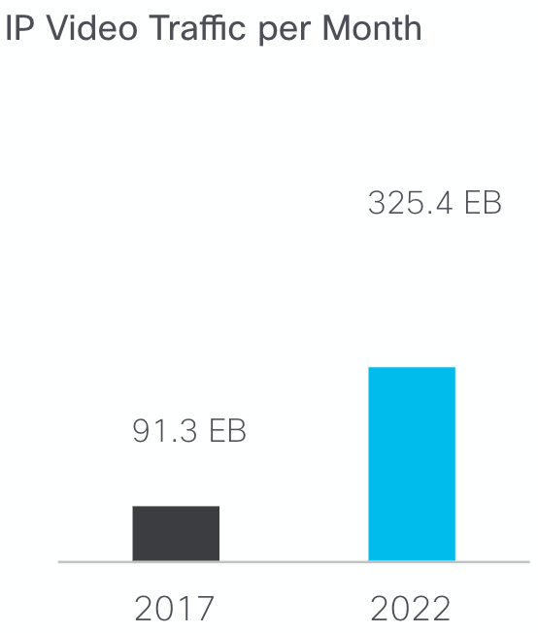
Larger Volume & Demand
According to Cisco [1]
3-fold increase in IP traffic over the next 5 years (from 2017)
82% of all IP traffic will be IP video traffic (in 2022)
7 fold increase in video surveillance traffic (2017 - 2022)
[1] Cisco Visual Networking Index: Forecast and Methodology, 2017–2022. White Paper. Cisco Systems, Inc., 26 Nov. 2018
Notes:
It is nice to reference such forecasts in an introduction section of your thesis (if it is related with multimedia).
Larger volume & larger demand begs for better quality (and also is a result of better quality being used).
This is a 4 fold growth in the plot on the right.
EB = exabytes = 1 million TB
There are much more forecasts so do not hesitate to take a look on your own.

Slide 5
Technology Enablers...
(D)WDM
BANDWIDTH
GbE
HFC
PLC, UWB Wi-Fi
FTTx, xDSL
home
AVAILABILITY OF BANDWIDTH – wireless
office
travel
SCALABLE VIDEO CODING – stream bit-rate
adaptation to the network
HDTV
SDTV
PC
Mobile TV
CACHING – Content Delivery Networks (CDNs)
Notes:
We went a long road to reach a point in which we are today.
I (i.e., JN) don’t know about you, but I prefer to consume content through a wireless network. In fact, I do not have a fixed internet connection in my home.
CDNs are a large part of what makes Netflix look good in comparison to competitors.

Slide 6
Technology Enabler –
Upload Bandwidth
New ways to use the media
Media Personalization
Injecting Advertisements
Citizens' Journalism
Internet Encyclopaedias
Photo Services
Notes:
We are not only the consumers, but also the producers.

Slide 7
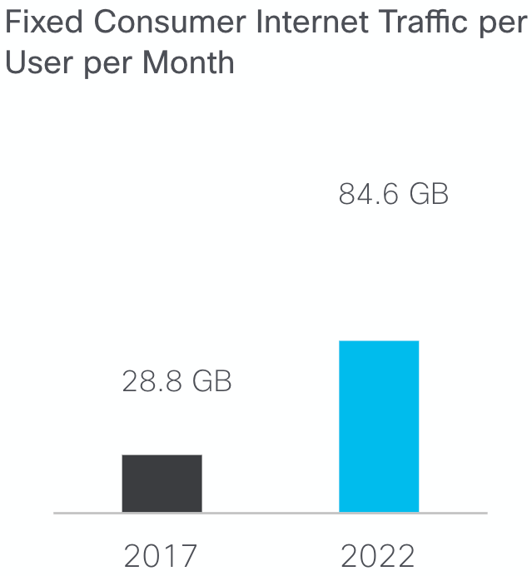
Upload Increase
According to Cisco [1]
the average internet user will generate 84.6 GB of traffic per month (by 2022)
up 194% from 28.8 GB in 2017
[1] Cisco Visual Networking Index: Forecast and Methodology, 2017–2022. White Paper. Cisco Systems, Inc., 26 Nov. 2018

Slide 8
Quality of Service
bandwidth
DATA TRANSMISSION
VIDEO TRANSMISSION
VOICE TRANSMISSION
losses
delay
Notes:
Mówimy o opóźnieniu, przepustowości oraz stratach ruchu. Tu pokazujemy wymagania per-serwis.
QoS - possible to be objectively measured. I can measure a time, delay and number of lost packets.
Various transmissions are sensitive to various degrading factors:
Voice transmission - requires low bandwidth, but sensitive for the delay
Data transmission - may require high bandwidth, but can tolerate the delay
Video transmission - requires high bandwidth, is able to recover from losses, but does not tolerate the delays

Slide 9

Quality of Experience (QoE)
Quality of Service (QoS), not enough for service providers
Real challenge - Quality of Experience (QoE)
Global issue, significant trend in development of multimedia systems
For video: Video Quality Experts Group
Notes:
I know how many packets I have lost, but what does the end-user think about it? - the question many board members of Internet Provider companies asked

Slide 10

QoE by White Book of QUALINET Network
The QoE research topic is related to the “degree of contentment or annoyance of the user of the application or service. QoE results from the fulfillment of the user's expectations regarding the usability and/or satisfaction of the application or service in the light of current user preferences.”
Notes:
There is a newer definition from The QoE Book
QoS - objective
QoE - subjective
Current preferences and expectations are important phrases here.

Slide 11

QoE by The QoE Book
“Quality of Experience (QoE) is the degree of delight or annoyance of a person whose experiencing involves an application, service, or system. It results from the person’s evaluation of the fulfillment of his or her expectations and needs with respect to the utility and/or enjoyment in the light of the person’s context, personality and current state.”
Adapted from Möller, S., & Raake, A. (Eds.). (2014). Quality of Experience. https://doi.org/10.1007/978-3-319-02681-7

Slide 12
Aspects of Media Ecosystem
Content
Delivery
QoE
Usability and Interaction
Business Model
Notes:
QoE as a point of contact between all of those.
QoE has a significant impact

Slide 13
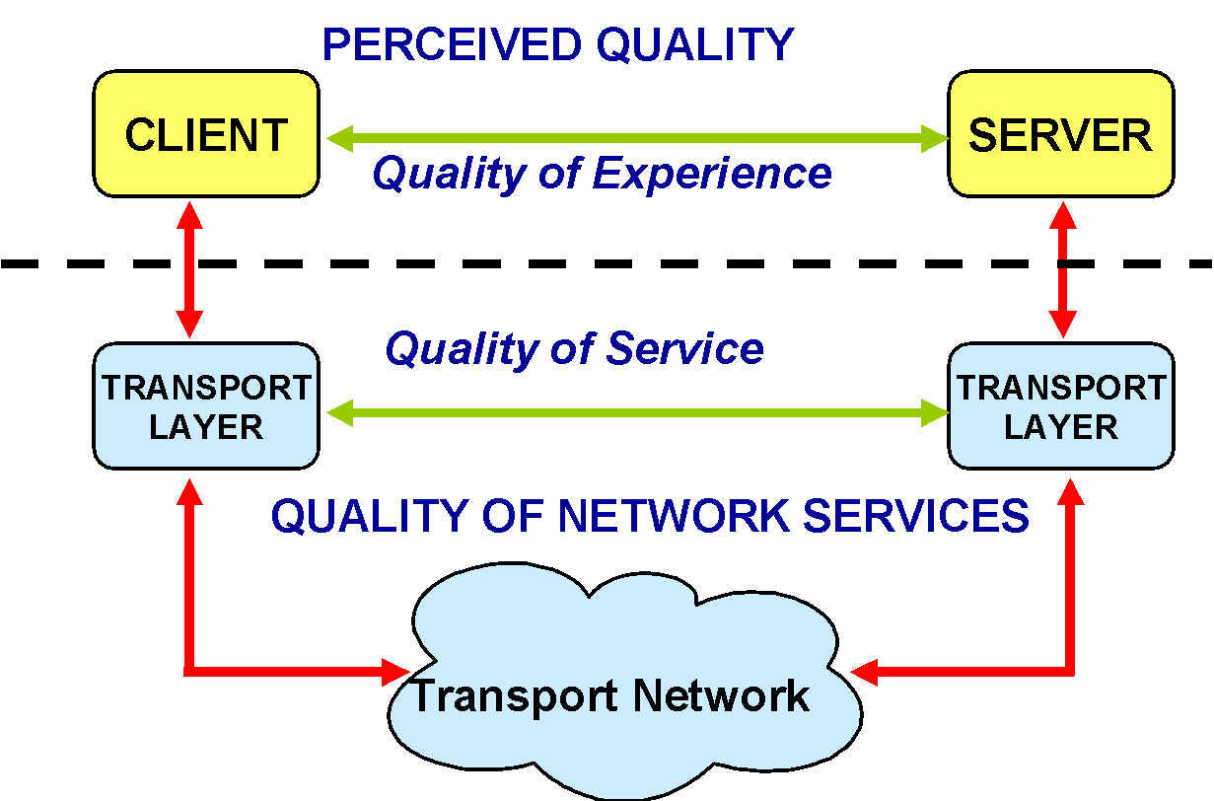
Quality of Service?
Quality of Experience?
Notes:
Vertical axis denotes a layer. At the top - (there should be) a user of the client & owner of the server.
QoS - countable and easier to measure.
QoE - difficult to measure, but better correlates to actual quality.

Slide 14
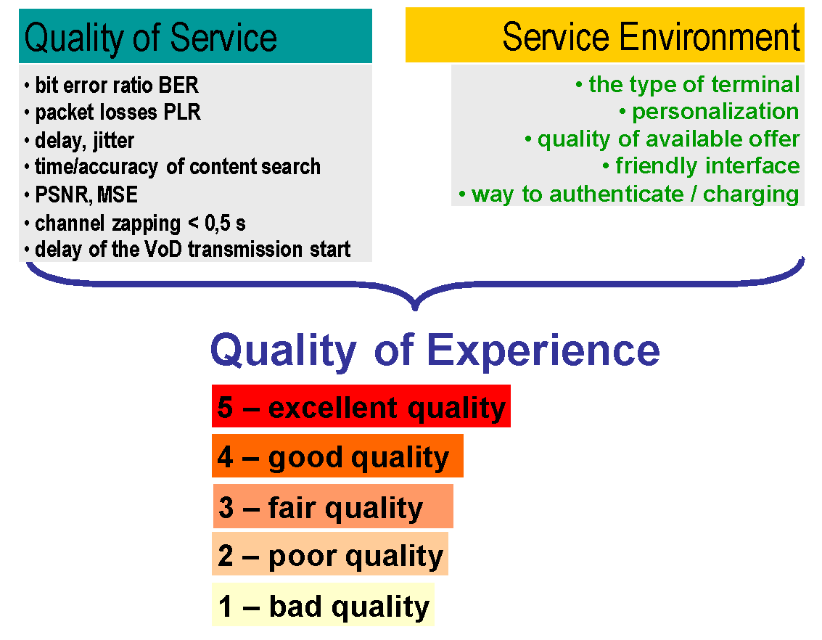
Quality of Experience
Notes:
QoE includes QoS

Slide 15
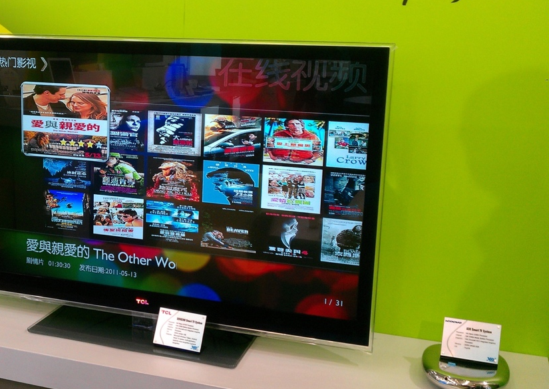
Multimedia Quality Problem
Over-The-Top (OTT) video streaming
Multimedia market competition
Quality-driven customer churn
What is far end quality?
By VIA Gallery from Hsintien, Taiwan – VIA QuadCore @ Computex 2011-Smart TV Video on Demand, CC BY 2.0, https://commons.wikimedia.org/w/index.php?curid=38934022
Notes:
The demand for quality is constantly rising. Whenever I can compare some old solution with the new one, the old is rated lower than before.

Slide 16
From Quality of Service (QoS) to Quality of Experience (QoE)
QoS
Quality model
QoE
Pixels
Calibration
What we know
What we build
What we want
Notes:
The next slide: so how do you get the calibration data?

Slide 17
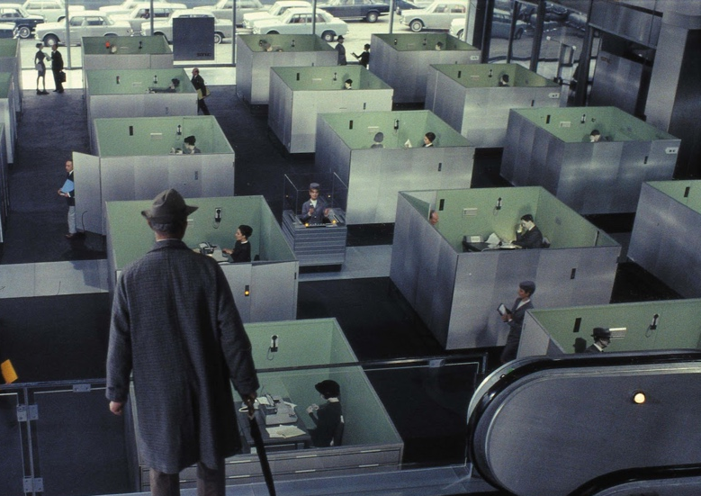
Obtaining Calibration Data
Basically, subjective scores
Hundreds to thousands needed
Various content, quality, people, etc.
Homogeneous conditions
Notes:
Subjective Methods for Measuring QoE start here - must be done on 29/30 Nov

Slide 18

New Building for AGH Department of Telecommunications

Slide 19
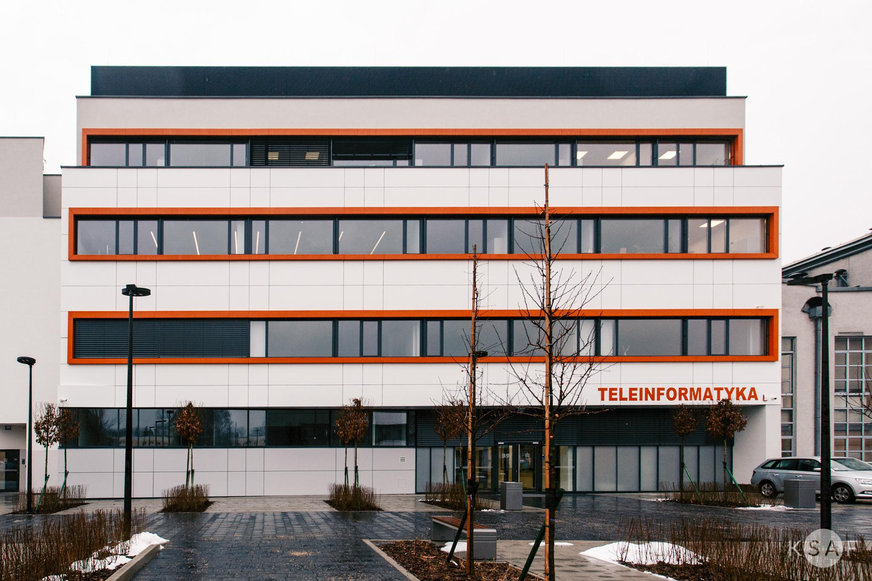
QoE Laboratory - Outside

Slide 20
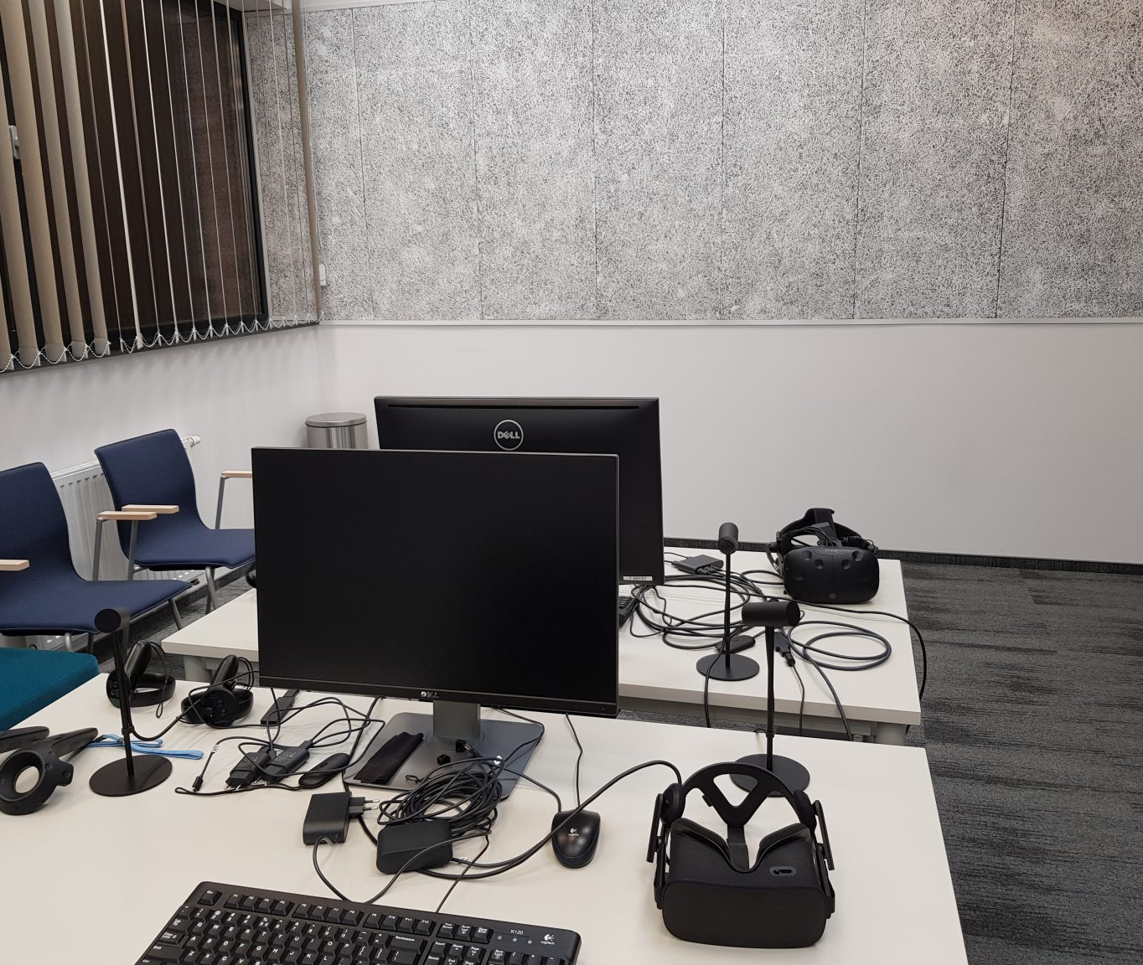
QoE Laboratory - Inside

Slide 21
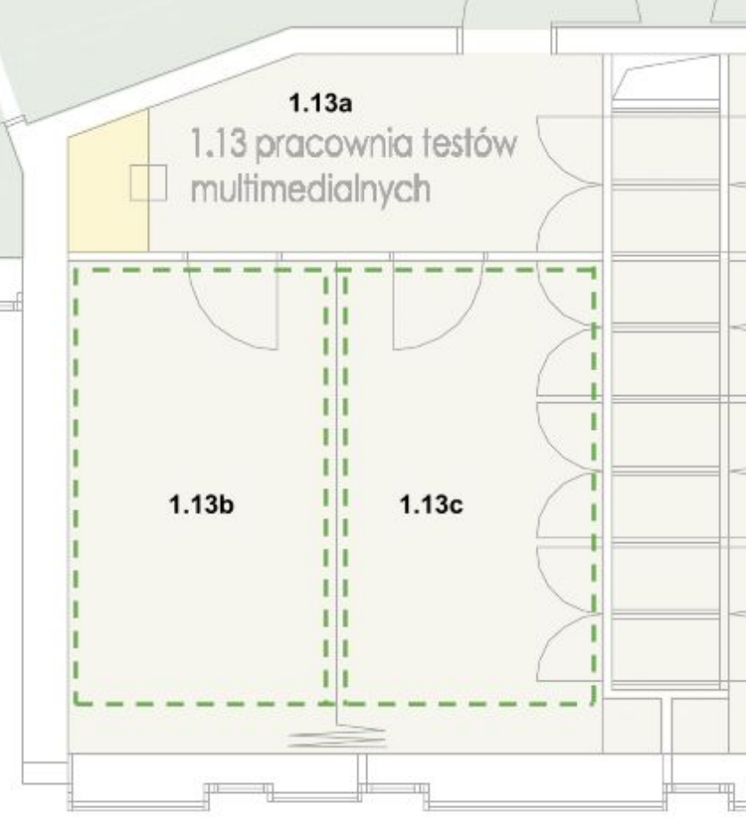
Laboratory of multimedia tests

Slide 22
Idea of Psychophysical Experiments (Subjective Tests)
User opinion = final score
Asking users about quality while using service - difficult or impossible
Subjective experiment - often best option to collect users' opinions
Controlling distortions
Controlling use case
Notes:
User opinion - so called ground truth (i.e. provide by direct observation and not coming from inference)
Controlled environment - get rid of, hopefully, all confounding factors.

Slide 23
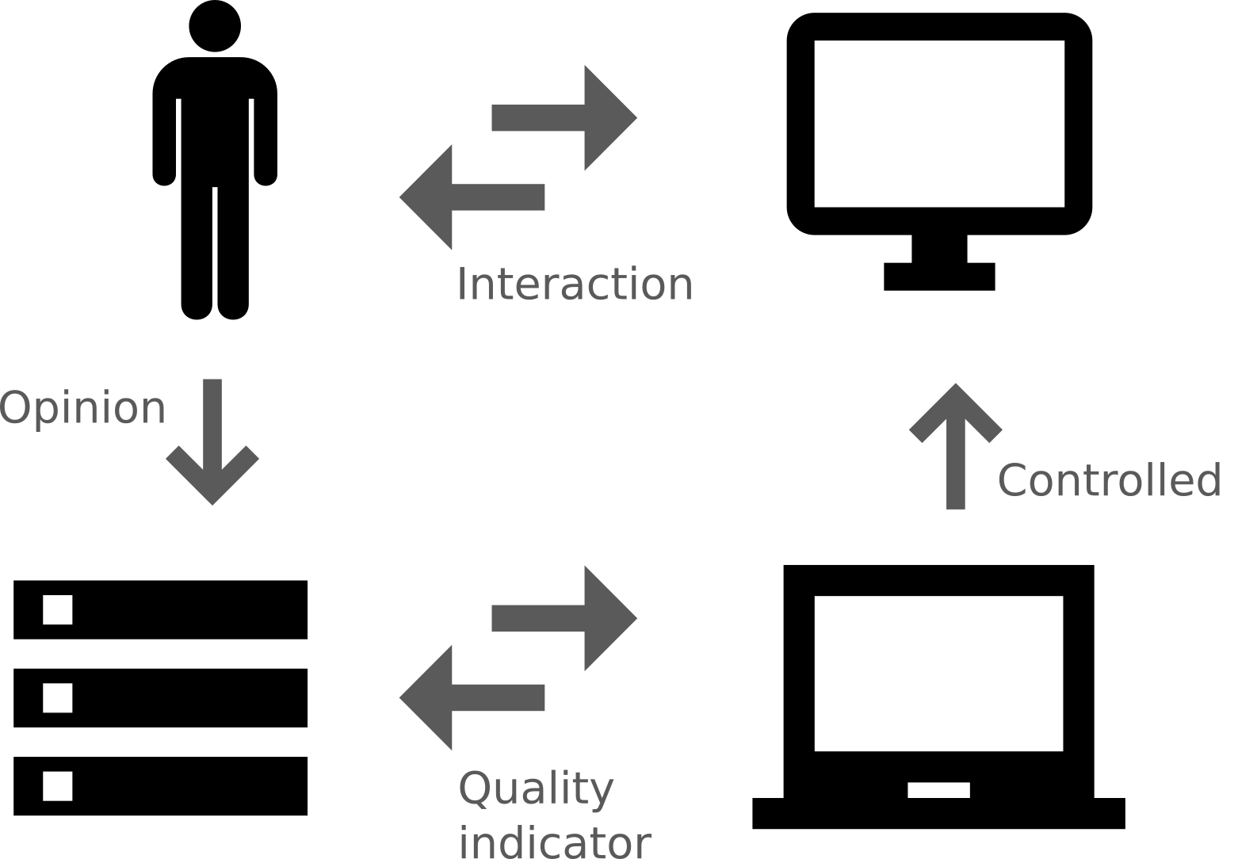
Subjective Experiment

Slide 24
Psychophysical Experiment (Subjective Test)
Sources (SRC)
Hypothetical Reference Circuits (HRC)
Processed Video Sequences (PVS)
Mean Opinion Scores (MOS)
Notes:
Explain the terms

Slide 25
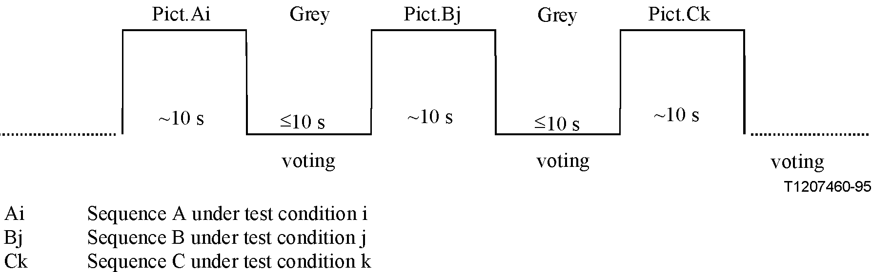
Absolute Category Rating
Training & actual experiment sessions
Each sequence rated individually (ACR scale)
Labels on scale: bad, poor, fair, good, excellent
Translated to values 1-5 when calculating MOS
Notes:
PVSs rated one-by-one; no explicit comparisons; labelled, ordinal scale

Slide 26
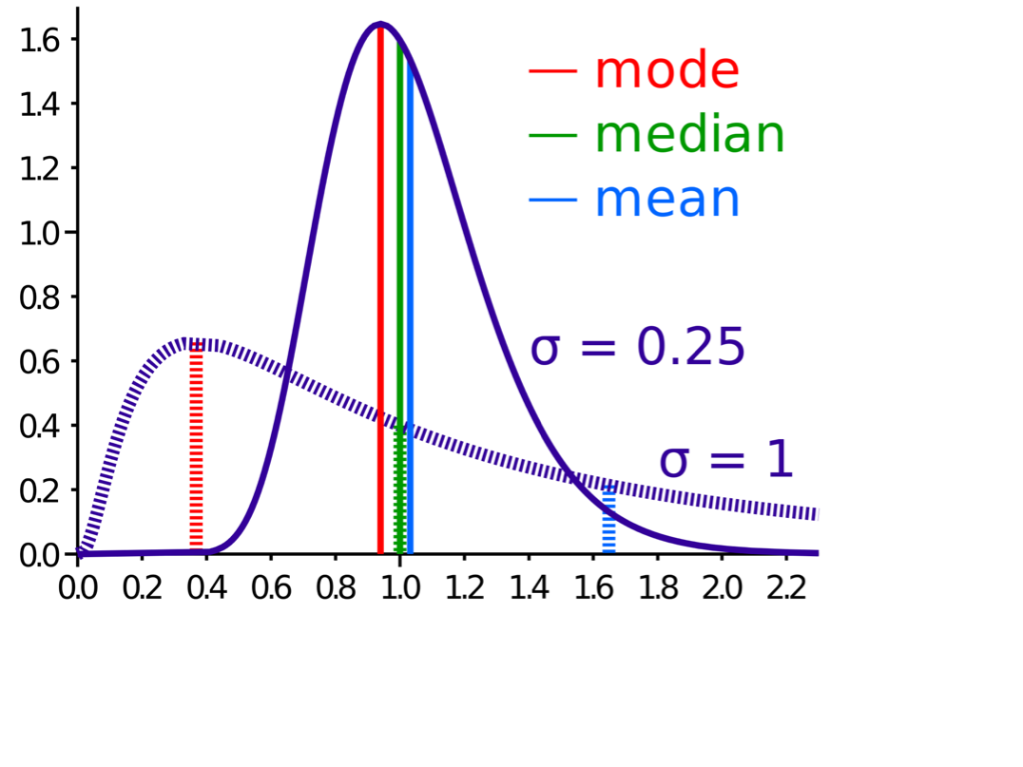
Analysis of Results – Average
Average (mean) score for each:
Subject
PVS
HRC
Mode and median less common
By Cmglee – Own work, CC BY-SA 3.0, https://commons.wikimedia.org/w/index.php?curid=15147460
Notes:
Notice how the mean differs for distributions having the same median.

Slide 27
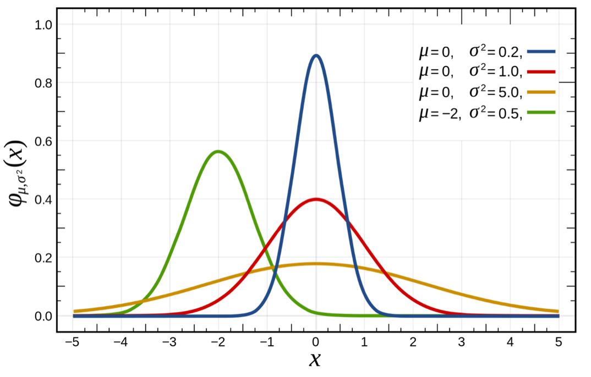
Analysis of Results – Normal Distribution
Each subject – different rating patterns
Some subjects not using entire scale
But histogram to look normally distributed

Slide 28

Analysis of Results – Student’s t-Test
t-Test – statistical hypothesis test
Used to determine if two sets of data significantly different from each other
Most applied when normal distribution
Testing e.g., if perception threshold quality distinguishable from SRC quality

Slide 29
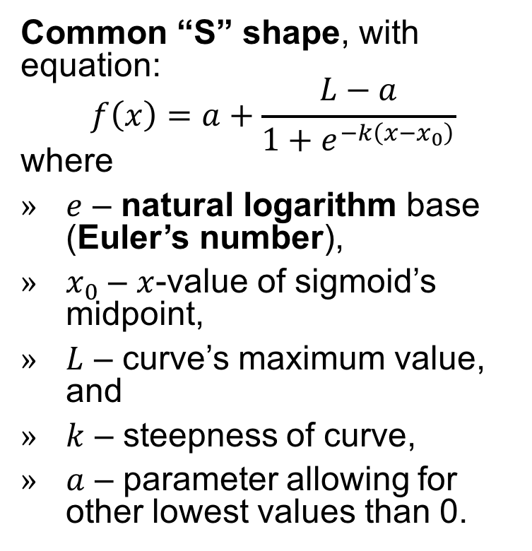
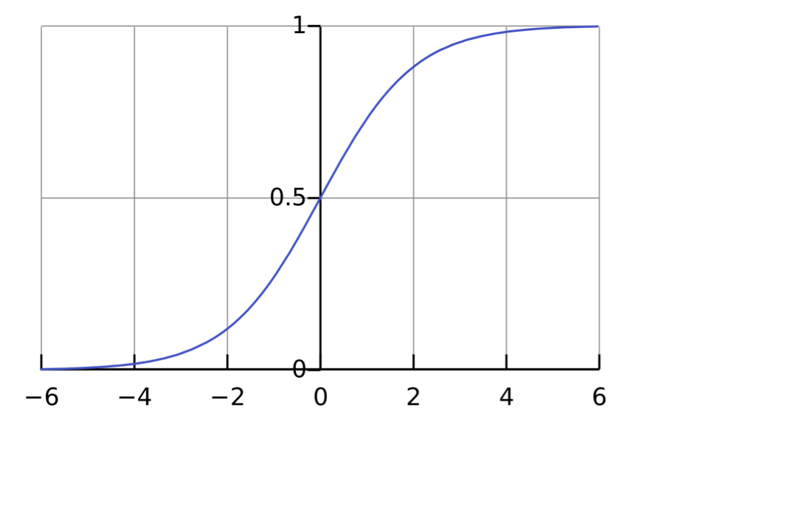
Analysis of Results – Modelling using Sigmoid (Logistic) Function
By Qef (talk) – Created from scratch with gnuplot, Public Domain, https://commons.wikimedia.org/w/index.php?curid=4310325
Notes:
It is most often used to weigh the importance of some phenomena (e.g. brightness or contrast).

Slide 30
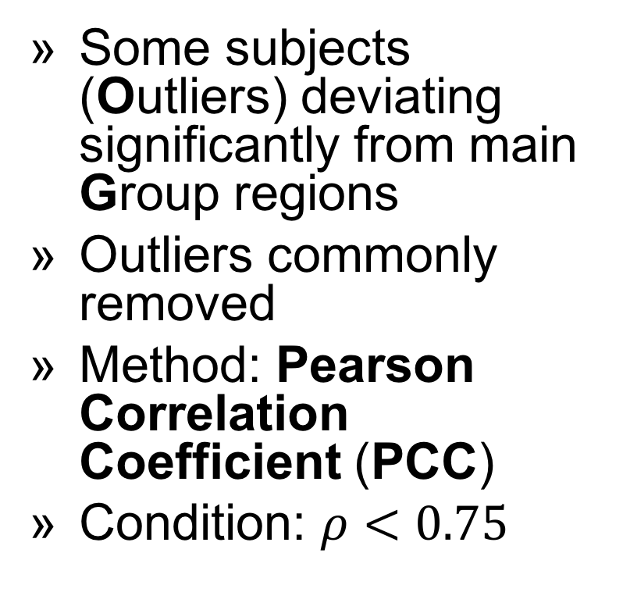
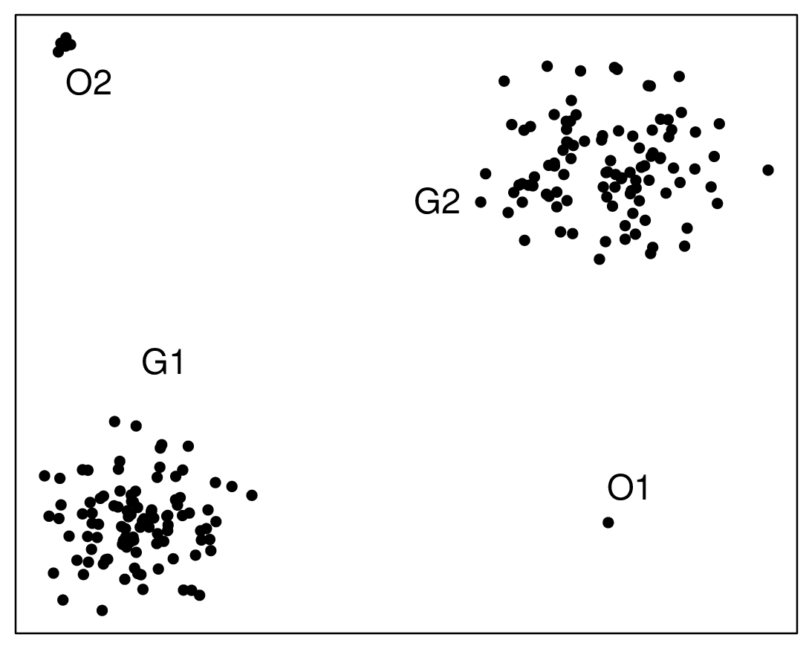
Analysis of Results – Outliers
By Osrecki – Own work, CC BY-SA 4.0, https://commons.wikimedia.org/w/index.php?curid=48650484

Slide 31
Dark Side
Subjects scoring whole experiment not just single sequence
Correct experiment needing careful preparation
In general asking people about anything – tricky
Obtained conclusions to consider experiment limitations
Notes:
Problem of comparing results from different experiments

Slide 32

Implementation of Key Performance Indicators (KPIs) for Quality Measurement
Notes:
Objective measurement of QoE starts here - present it on Dec, 6 2018
Not only implementation, but also the general description
Special type of quality - subjectively perceived quality

Slide 33

General Information
Algorithmic approach to visual quality assessment:
repeatable
easy to manipulate
countable
implementable
Notes:
Repeatable: more stable than asking people about the quality
Easy to manipulate: possible to map it to other measures, one may look for correlation between various phenomena, in general, application of mathematics is possible!
Countable: good medium for comparison of various visual materials
Implementable: can be (and was) transferred to both software and hardware solutions

Slide 34

General Information
Measurement targeting many artifact sources:
capturing
processing
transmission
display
Notes:
capturing: optics non-ideality
processing: mainly compression and rescaling
transmission: lossy medium
display: low dynamic range, smaller colour gamut
targeting specific distortions should give higher accuracy

Slide 35

General Information
Results reflecting subjectively perceived quality:
correlation with human perception of visual artifacts
signal-based approach (so called No-Reference approach)
Notes:
KPIs - objective quality measure (any numerical value),
People’s opinion - subjective quality measure (usually Mean Opinion Score)
Non-trivial goal - in practice, one has to run subjective tests
If human perception is the most important, then let’s focus on visual signal and not compression, transmission parameters and so on

Slide 36
No-Reference Approach
Opposite to Full-Reference approach
Easily applicable to many scenarios:
No-Reference probe can be attached at any point of content delivery chain
no need of source material
access to visual content as the only one requirement
Notes:
Full-Reference is a classical approach - take each pixel from unmodified image and compare it with associated pixel in modified image
source material - unmodified, original, high-quality visual content (no compression, no lossy transmission)
One does not need to have knowledge about transmission, compression and display parameters

Slide 37
No-Reference Approach
Non-trivial:
based on Human Visual System (HVS) response to visual artifacts
no information about compression and transmission parameters
no direct way to compare with source material
Notes:
Not everyone has the same sensitivity for visual artifacts
It is not possible to apply simple pixel-to-pixel algorithm comparing modified and unmodified visual material

Slide 38
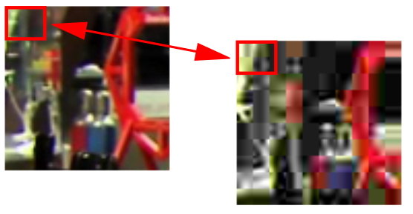
Other Approaches
Full-Reference:
applicable when source material is accessible
usually computationally intensive
good for content producers/modifiers
Notes:
In practice, this approach achieves higher correlation with subjectively perceived quality
Standardised approach used by many important players (e.g., Netflix)
Classical, well-defined

Slide 39
Other Approaches
Reduced-Reference
only some parameters about the source material and its processing are available
Bitstream-based
no need to access visual signal
ongoing development by standardisation parties
Notes:
Bitstream-based:
one wants to say as much as possible about the visual content by looking on the transport layer (but not only)
can be applied at many points of delivery chain
can be used with encrypted signal
modular build: if only transport level - transport level measurements, if more - more

Slide 40
Exploitation of Results Coming from AGH QoE Research

Slide 41
Our Experience
Standardized experiment preparation
Proposed new methods for subjective experiments
Proposed new methods to analyze subjective experiment results
Prepared and run numerous experiments, so…
Done a large number of errors, on which we drew conclusions ;-)

Slide 42
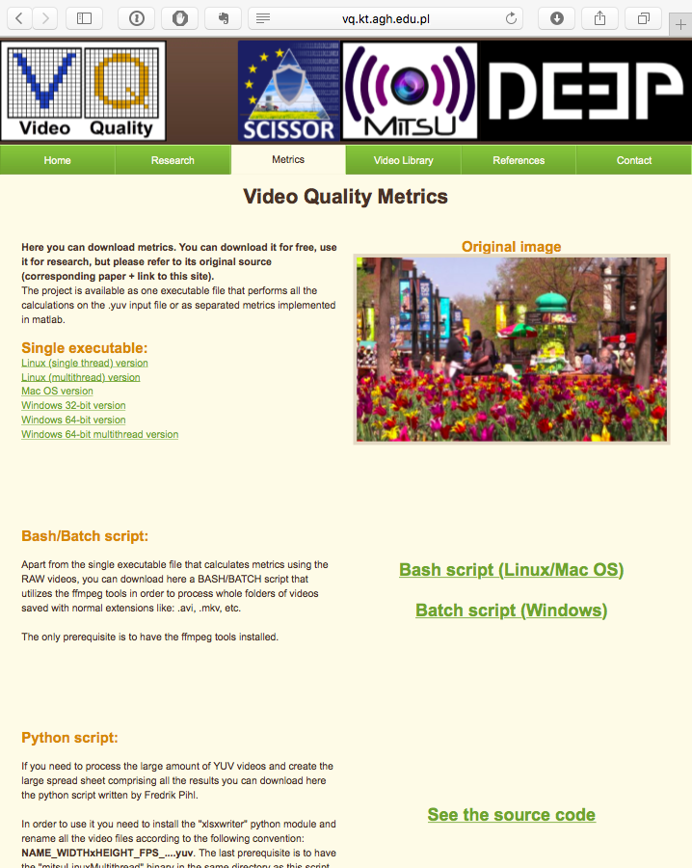
AGH Implementation of Video Quality Indicators
15 Video Quality Indicators (VQIs)
Implemented in C
Binary executables freely available online at: http://vq.kt.agh.edu.pl/
Source code available for research upon request
Notes:
VQIs is just our name for KPIs
C implementation makes it easy to port the algorithms to various platforms
Tested quite well (e.g., by licensing parties)

Slide 43
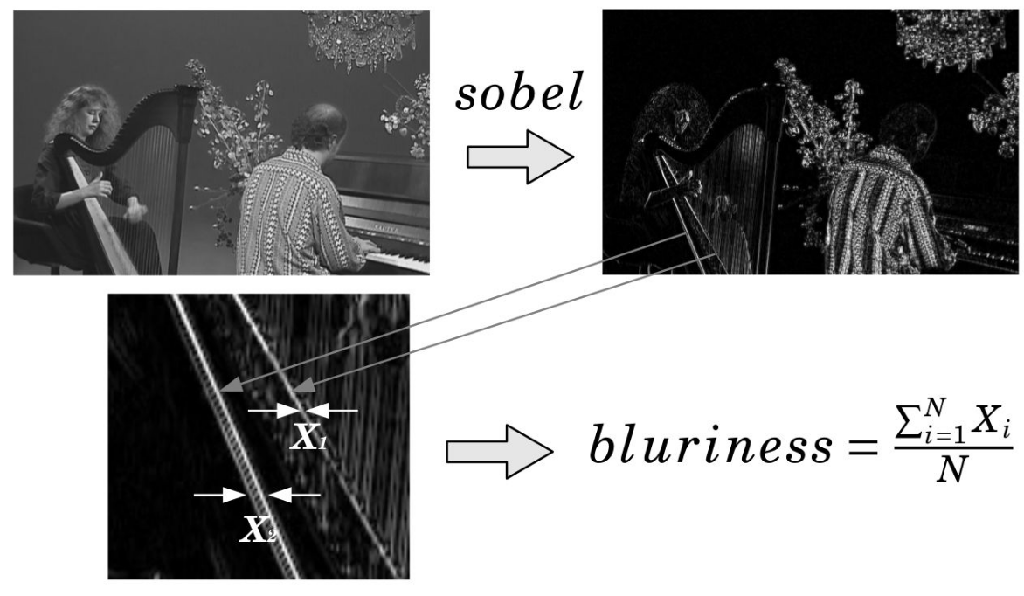
Example: Blur VQI
Notes:
Execution flow:
Read Y channel from YUV image,
Find edges using Sobel filter,
Measure width of edges
Only a subset of existing edges are chosen (based on dynamically calculated threshold value derived from standard deviation for a given macro block)
Result is proportional to mean width of edges

Slide 44







R&D Projects

Slide 45

Cooperation (1/2)
Video Quality Experts Group
Since 2008
Members of VQEG Board
Co-chairing 3 projects with:
University Ghent (BE)
University Nantes (FR)
Rohde & Schwarz (CH)
NTIA (US)
Cooperation on experiment preparation
Video Quality in Public Safety
Since 2010
Supported by U.S. Department of Homeland Security
Developing user guides for public safety video applications

Slide 46


Cooperation (2/2)
Polish Ministry of Digital Affairs
Since 2014
Received nomination as delegate of Poland
International Telecommunication Union - Telecommunication Standardization Sector
Since 2014
Turning research results into standards

Slide 47
Standardization
ITU-T Recommendation P.912
ITU-T Recommendation J.346
“Subjective video quality assessment methods for recognition tasks”
Contribution - major (⅔) extension, e.g.:
Source signal
Test methods
Experimental design
Reference, viewing and listening conditions
“Hybrid bit-stream perceptual models for objective video quality measurements”
Contribution - technical findings as member of Independent Lab Group (ILG)

Slide 48

Commercial Exploitation (Technology Transfer)
License agreement signed in 2013
License agreement being signed

Slide 49
Knowledge Dissemination
Almost 100 scientific papers published on QoE
More than 10 scientific conferences and special sessions organised
More than 10 journal special issues published, with QoE topics
Almost 100 conference talks on QoE

